Slide 1
SOCIAL SEEDS – Towards a socially responsible and innovative Europe
Mária BARACSI
Coordinator, IFKA Public Benefit Nonprofit Ltd. For the Development of the Industry
baracsi@ifka.hu

Slide 2
The reasonable man adapts himself to the world; the unreasonable one persists in trying to adapt the world to himself. Therefore all progress depends on the unreasonable man.
George Bernard Shaw, Man and Superman (1903)

Slide 3
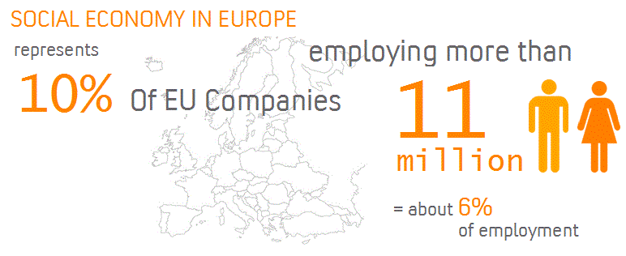
Did you know that….?

Slide 4
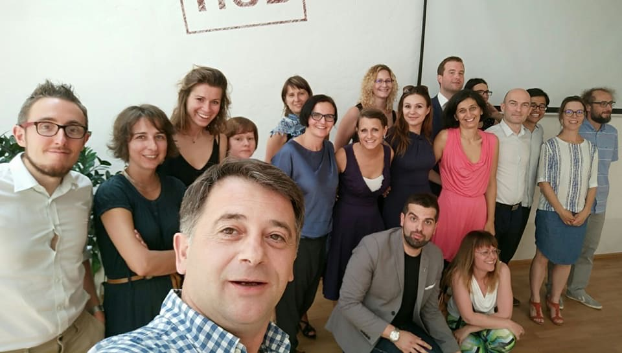
What is happening in CEE?

Slide 5
SOCIAL SEEDS in a nutshell
to equip policymakers with evidence-based policy diagnostic tool that increases the effectiveness of local and regional policies and instruments for stimulation of growth and employment (preferably of vulnerable social groups) in social enterprises (SE) including their ecosystems in Europe,
Three-stage development programme for better social entrepreneurial ESIF policy instruments:
Policy instruments:
Employment capacities of social enterprises will be strengthened
Improved access of enterprises – including social enterprises working for society – to external funding, which realize investments that stimulate employment
Stage 1: Scanning of the social enterprise landscape (best practices, policy analysis, seminar, study-visits)
DEVELOPMENT PHASE
Stage 2: Policy knowledge exchange and mentoring (mentee – mentor regions, comparative analysis, networking, interregional seminars)
MUTUAL LEARNING PHASE
Stage 3: Policy improvements (Policy Diagnostic tool, INTERREG EUROPE Policy Learning Platforms, clustering with other projects and initiatives)
REGIONAL ACTION PLANS + CALLS FOR PROPOSALS

Slide 6
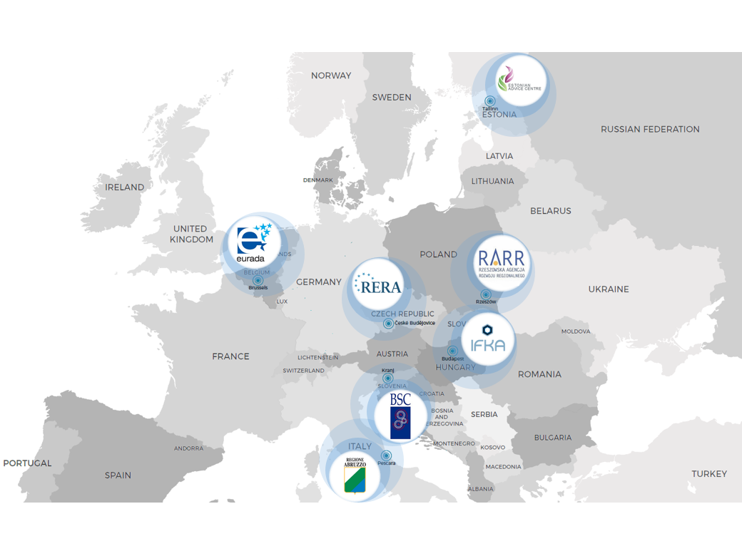
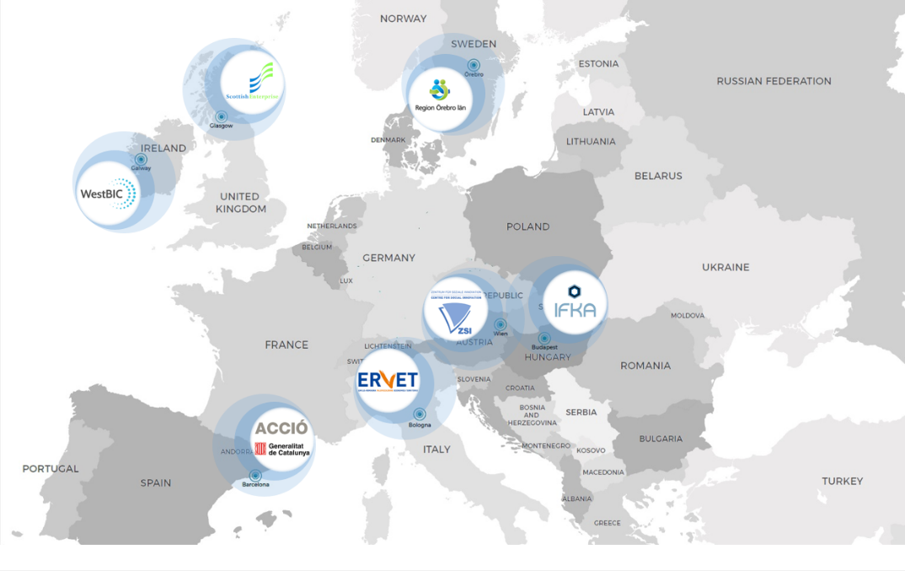
SOCIAL SEEDS in a nutshell
RaiSE
SOCIAL SEEDS

Slide 7
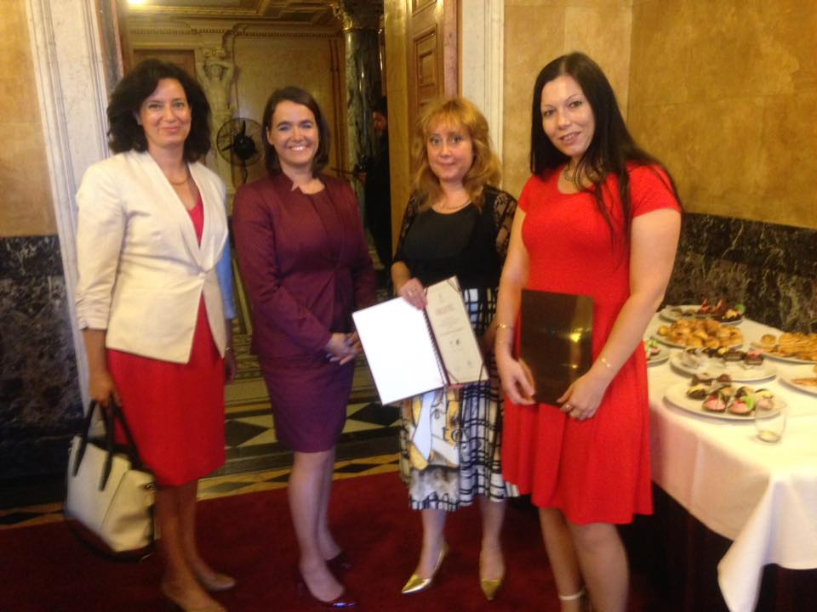
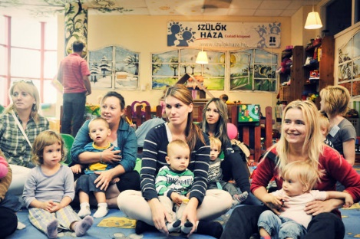
Good practices – Parents’ House
Cultural and mental hygenic institution specialized in children day care founded in 2007 by social politician,
Builds on a methodology, business model and training
120 hour long training for employees, extension courses,
Standardized, continuously improved professional program – continuous quality control
Achievements:
1st place: ‘Family-friendly workplace’ (2016),
1st place: ‘You are worth more’ by Vodafone (2012),
awarded “Best Practice” by the European Foundation for the Improvement of Living and Working Conditions EUROFOND (2012),
admitted as a best practice by The World Bank (2014),
Support from CSR companies (e.g. Audi ETO KC, Univer, Coop, Gyermelyi Tészta Ltd., Council of Újbuda)
Key to success: mindset-changing impact, flexibility, sustainable business model, connects the civil, that public and the private sector,
Financial challenges: venture (70-80% of revenues), the local government, the state (support and tenders) and the business sector (CSR-based cooperation).

Slide 8
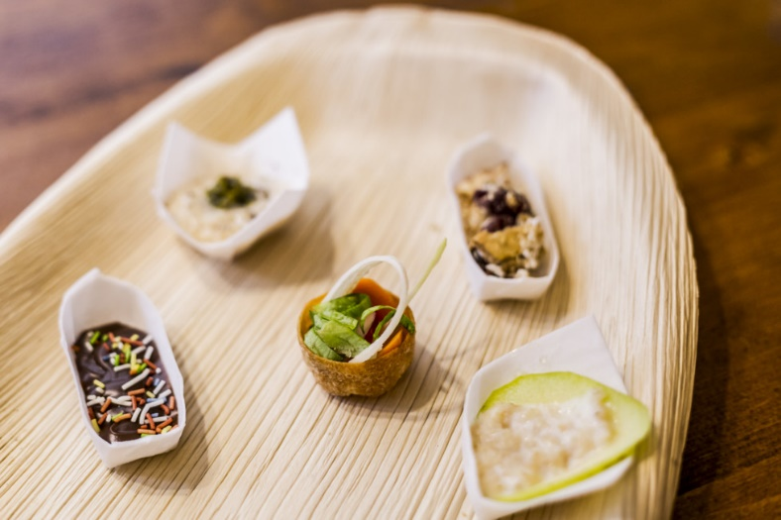
Good practice – Bistro No Waste
Established in 2016 offering eco-catering in Budapest (start-up SE)
Achievements:
environmental sustainability through a 70-70-70 rule, which means that 70% of their food is made of bio ingredients, 70% of the offered food and vegetables is seasonal and is obtained from a maximum of 70 km distance,
only a few types of dishes every day, but the variety always covers a wide range of food: they always have dishes for meat-eaters, vegetarians, vegans and the curious. They also offer different types of Hungarian craft beer and wine from Hungarian suppliers.

Slide 9
Step 1 – Screening of the social enterprise landscape

Slide 10
Methodology – mentor – mentee „pairing”
SOURCE
Step 1: Desk research (literature review of country reports, Operational Programmes, stakeholder profiles)
Step 2: Stakeholder Group Meetings conclusions (Individual interviews, Focus groups)
Step 3: Good practice collection (bottom-up)
Step 4: Qualitative & quantitative explanatory research (definition of indicators for comparison)
Step 5: Conclusions and pairing of regions (visualization via spiderweb charts)
UNIQUE QUALITATIVE
&
QUANTITATIVE METHODOLOGY APPLIED
Benefits:
information is richer and has a deeper insight into the phenomenon under study
ANALYSIS

Slide 11
Policy landscape in SOCIAL SEEDS countries
Partner countries / regions | BE | HU | CZ | PL | EE | SI | IT
AWARENESS RAISING (e.g. award schemes, communication, advocacy) |  | X |  |  | X |  | 
SOCIAL ENTREPRENEURSHIP EDUCATION (e.g. academic courses) |  |  | X |   | X |  | 
PRE-START / START-UP SUPPORT Business support e.g. mentoring, consultancy, coaching etc. Grants Infrastructure e.g. incubators |  | X |  |  | X |  | 
GRANTS AND BUSINESS SUPPORT FOR ESTABLISHED ENTERPRISES (e.g. business planning, management skills, marketing, training and coaching etc.) |  |  | X |  |  |  | 
INVESTMENT READINESS SUPPORT | X |  | X | N/A |  NFCS | X | 
DEDICATED FINANCIAL INSTRUMENTS (e.g. loans, guarantee schemes, social impact bonds etc.) |  |  | X | Pilot phase | X | X | 
PHYSICAL INFRASTRUCTURE (e.g. shared working space) |  | X | X | N/A | X | X | 
COLLABORATIONS AND ACCESS TO MARKETS |  | X | X | N/A | X | X | 
NETWORKING, KNOWLEDGE SHARING AND MUTUAL LEARNING INITIATIVES |  | X |  | X | X | X | 

Slide 12
Qualitative & quantitative explanatory research
Well-functioning ecosystem
(a)
Legal definition (non profit, for profit, hybrid business models)
Policy niches in vertical and horizontal policies
(b)
Access to finance
Policy measures facilitating social entrepreneurship (c)
Scope of measures (increase in employment, education,etc.)
Sectoral characteristics (primary, secondary, tertiary),
Lifecycle stage (early-stage, investment-ready),
Ecosystem enablers (seeds, developing, mature, declining),
Opportunities and barriers
Narrative on policy improvement necessity
Capacity-building (e.g. networking)
Internationalization
Skills enhancement
Access to market

Slide 13
Benchmarking of SOCIAL SEEDS countries
 | BE | HU | CZ | PL | EE | SI | IT
Well-functioning ecosystem (a) |  |  |  |  |  |  | NA
Policy niches in vertical and horizontal policies (b) |  |  |  |  |  |  | NA
Policy measures facilitating social entrepreneurship (c) |  |  |  |  |  |  | NA

Slide 15
Mentor-mentee relationships
Slovenia | Hungary Belgium Poland | NETWORKS
Hungary | Slovenia Belgium Estonia Poland | ECOSYSTEM
Belgium | Estonia Hungary Slovenia Poland | SOCIAL IMPACT MEASUREMENT
Poland | Slovenia Belgium Hungary | KNOW-HOW EXCHANGE + INTERNATIONALIZATION
Estonia | Hungary Belgium | STRATEGY
Czech Republic | Estonia Belgium | IMPROVING EARLY-STATE SEs + FINANCIAL SUPPORT

Slide 16
Step 2 – European Standardized Evaluation and Supporting System

Slide 18
TEMPEST European Standardized Evaluation and Supporting System
An Integrative Model for Social Entrepreneurship (Technology) Readiness Assessment,
The TEMPEST methodology leverages its unique framework of 7 themes, 21 sub-themes and 84 (coded) quantitative indicators to deliver evidence-based insights that address scientific and policy issues.
TEMPEST offers an integrative approach where data points can be compared and contrasted to show benefits and barriers in social entrepreneurship and the ecosystem,
Use: provide information to policymakers on the maturity of the social enterprise sector and showcases areas where public support is needed.

Slide 19
Policy diagnostic tool – good practices
Regulatory framework (taxation, code of labour, legal definition)
Social innovation (services)
Improving social entrepreneurial policies
Social entrepreneurship skills & competencies
Access of finance (seed- & venture capital investors)
Cooperation atmosphere (PPP, business relations)
Social impact

Slide 20
European Standardized Evaluation and Support System

Slide 22
Questions?

Slide 23
Thank you!
Questions welcome

